Slide 1
Introduction
For this topic we will be focussing on the following:
Using PHP to Edit and Save a File on the Server

Slide 2
Using PHP to Edit and Save a File on the Server – Part 1
In order to Edit and Save a File on the Server we need the following things:
A Text File that is located on the Server and it must contain some sample text
A PHP Script that contains a Form that will display the content of the Text File along with a Save File button
A PHP Script that will save the contents of the Edited File on the Server and display those contents on the Web Page itself

Slide 3
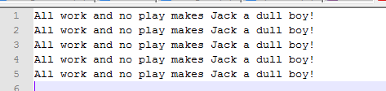
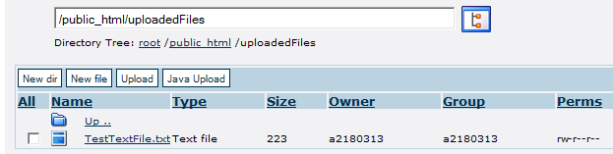
Using PHP to Edit and Save a File on the Server – Part 2
The Text File
The Text File that I am going to use contains the following content:
I have saved it using TestTextFile.txt as a Filename
It is stored in my uploadedFiles Folder on the Server:

Slide 4
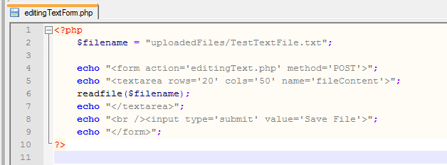
Using PHP to Edit and Save a File on the Server – Part 3
The PHP Script for the Form
The following PHP Script is used to generate the form that will display the content of our TestTextFile.txt File and it will allow us to click on the Save File button that will take us to another PHP Script called editingText.php:

Slide 5
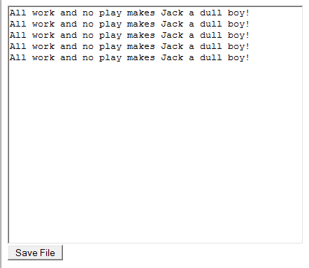
Using PHP to Edit and Save a File on the Server – Part 4
Once you run editingTextForm.php in your Browser you should get:

Slide 6
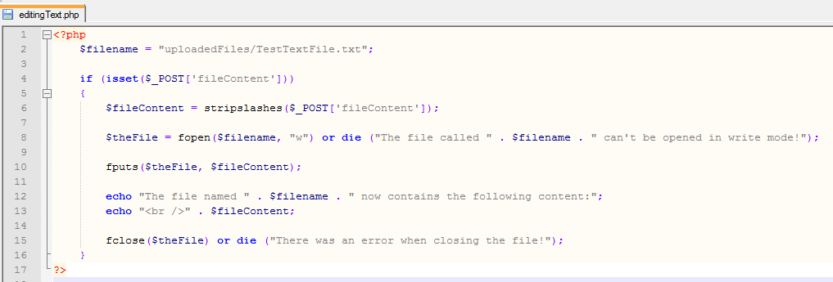
Using PHP to Edit and Save a File on the Server – Part 5
The PHP Script that will Save the Edited Text File on the Server:

Slide 7
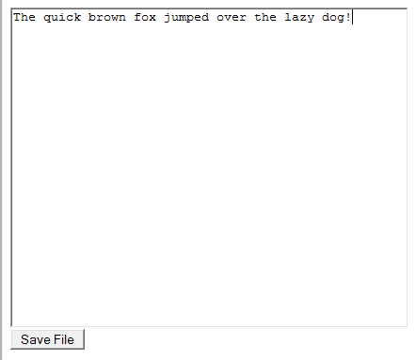
Using PHP to Edit and Save a File on the Server – Part 6
Next we will need to test the file by changing the content:
Once you have changed the content then you will need to click on Save File

Slide 8
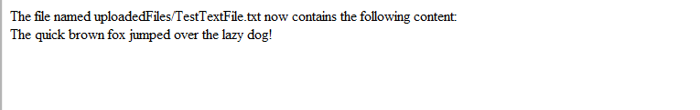
Using PHP to Edit and Save a File on the Server – Part 7
And you should get the following screen:
Now hopefully everything should have happened as planned and the text above should now be stored in the Text File!

Slide 9
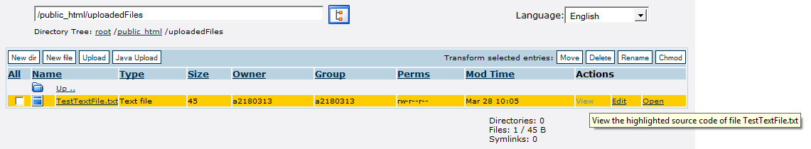
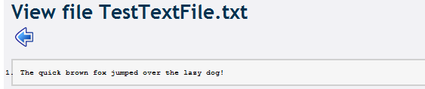
Using PHP to Edit and Save a File on the Server – Part 8
One Final Check
Make sure that you view (Click on View in Actions) the content of the Text File on your Server to make sure that it does contain the Edited Text and not the Original Text:

Slide 10
Exercises
1 – Uploading a File to the Server
1a) Create PHP Scripts that will allow you to Edit and Save a File and on your Server
1b) Test your PHP Scripts and take screenshots in order to collect evidence that your Scripts work
2 – Find out the meaning and functionality of the following in PHP:
2a) stripslashes($_POST['fileContent']);
2b) fopen($filename, "w")
2c) fputs($theFile, $fileContent);
2d) fclose($theFile)
2e) $_SERVER["PHP_SELF"]
2f) readfile($filename)

